Slide 1


Future as the Present: Science Fiction Utopias and Dystopias from the Muslim World
dsd
Muhammad Aurangzeb Ahmad
Founder and Editor
Islam and Science Fiction Project
Center for Data Science
Department of Computer Science
University of Washington
Project Website:
Islamscifi.com

Slide 2

Meanings of Utopias/Dystopias
Utopias are a reflection of a group’s hope and aspirations for how a perfect society will look like
Dystopias are a reflection of how the society will look like if things went terribly wrong socially, culturally, environmentally etc.
The Muslim world is an artificial and real construct spanning 57 countries and three continents
Islamicate: Coming from or relating to Islam culturally or coming from the Muslim world

Slide 3
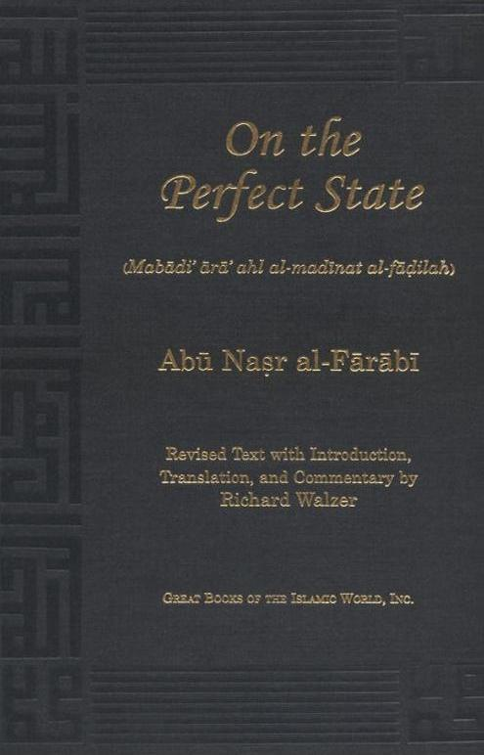
Al-Farabi’s City of Felicity
dsd
Author: Abu Nasr Al Farabi
Year: early 10th Century
Type: Utopia
Theme: Philosophical Utopia
Al-Farabi is considered to be one the greatest of the earlier Muslim Philosophers
Wrote ārā ahl al-madīna al-fāḍila (The Virtuous City) which is inspired from Plato’s Republic
Describes a perfect society ruled by enlightened Philosophers ruling on the basis of Islamic Principles
Also describes recipes for near-perfect societies
Became the basis of political discourse in the Islamic world for many centuries

Slide 4
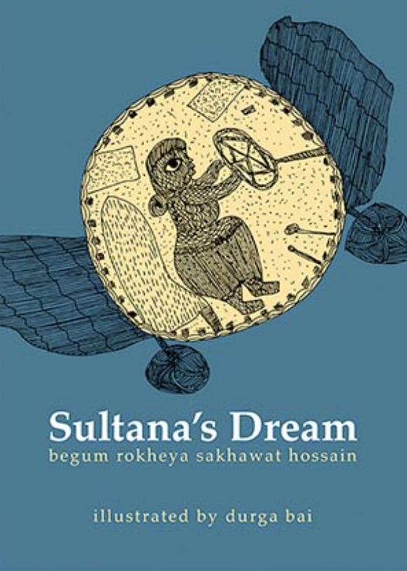
Sultana’s Dream
dsd
Author: Ruqaiya S.Hussain
Year: 1905
Type: Utopia
Theme: Feminist Utopia
Written by Ruqaiya Sakhawat Hussain, a Bengali Muslim woman in 1905
Considered to be the oldest work of Feminist Science Fiction
Ruqaiya also founded Anjuman e Khawateen e Islam (Islamic Women's Association) to foster education among Muslim women in Bengal India
Describes an alternate world where the world is run by women
A world which is focused on gaining knowledge and improving social conditions
Society is run on the principles of non-violence, cooperation and war is outlawed

Slide 5

Semavi Ihtiras
dsd
Author: Raif Recdet
Year: 1933
Type: Utopia
Theme: Secularist Utopia
A number of secularist utopias were written in Kemalist Turkey in the 1930s and 1940s
Semavi İhtiras (The Celestial Passion) is one of the earliest Turkish utopias
Describes the future of secular and republican Turkey
The story is about Nobel-prize winning Turkish authors and women who have many more freedoms as compared to the rest of the world including the contemporary West
The women in the novel have private jets which they use to fly over the world (freedom of mobility)
Religion has lost its hold over the masses

Slide 6

Al-Bud al-Khamis
dsd
Author: Ahmad Raif
Year: 1987
Type: Utopia
Theme: Religious Utopia
Written by a member of the Muslim Brotherhood while in jail in the late 1960s but was not published until 1987
A group of people get fed up by the problems and conflicts on Earth and take a rocket to Mars
The alien society is ruled by just rulers and the system of the planet is very similar to the moral and legal system of Islam
The utopia envisioned here is a reflection of how the Muslim Brotherhood envisioned a just society
It take a top down approach to governance but where people have internalized the system so that there is no coercion

Slide 7

Uzay Ciftcileri
dsd
Author: Ali Nar
Year: 1988
Type: Utopia
Theme: Religious Utopia
A group of people land on a planet inhabited by people from Earth who come from a Sufi Muslim background
Imagines a society that is run on Islamic principles of brotherhood and mysticism
It take a bottom up view of how to govern society
A perfect society is achieved by inner reflection

Slide 8

Utopia
dsd
Author: Ahmad Tawfik
Year: 2011
Type: Dystopia
Theme: Class Divisions
Describes a near future Dystopian Egyptian society marred with deep social and class divisions
The rich live is Elysian like conditions while the poor are living in forth world conditions
Middle Eastern economies have collapsed after the invention of a superfuel in the US and Oil reserves become useless
The Egyptian middle class has disappeared and the poor have degraded into barbarianism
Extrapolates the downward spiral of Egyptian society in recent decades into the future
The novel has become popular especially after the failure of the Arab Spring

Slide 9
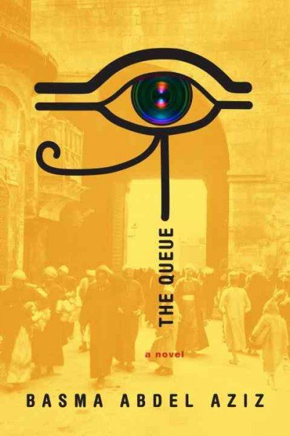
The Queue
dsd
Author: Basma Abdel Aziz
Year: 2016
Type: Dystopia
Theme: Totalitarian Regime
The novel is a reflection on the failure of the Arab Spring
Set in the aftermath an unspecified event known as the Disgraceful Event
Marriage of Kafkaesque bureaucracy and Orwellian Government
People are lined up against a government office (The Gate) to get their pleas heard
The queue has gown to be kilometers long
A whole community springs up around the queue with its own systems of barter and trade
Phones are given for free to the people in the queue (surveillance)
There is single paper called The Truth
Laws are arbitrarily handed down by the Gate

Slide 10
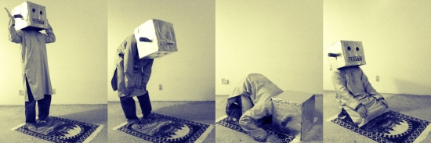
Conclusion
The future is the reflection of the present capturing our hopes, aspirations and fear
Just the past can be molded to fit one’s agenda so can the future!
The same is true from Utopias and Dystopias from the Muslim World
Pride and Prejudice and Robots by Muhammad Aurangzeb Ahmad and Zaid Ali

Slide 11
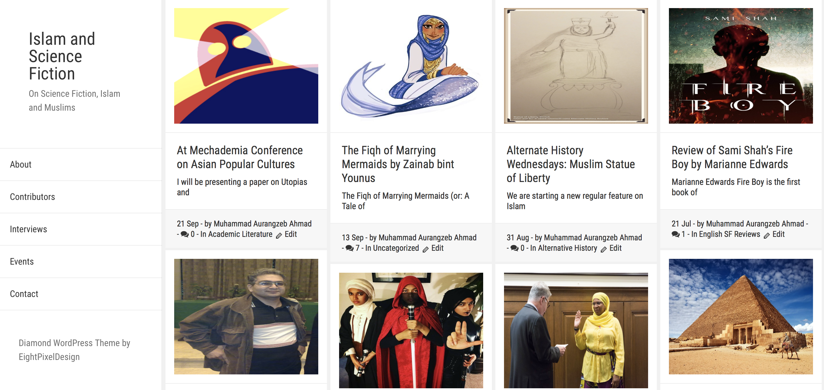
Additional Resources
Contact info:
Muhammad Aurangzeb Ahmad
Founder and Editor
Islam and Science Fiction Project
Center for Data Science
Department of Computer Science
University of Washington
email: maahmad@uw.edu
website: www.aurumahmad.com
Islam and Science Fiction Project
www.islamscifi.com

